Slide 1
Arcadia coding challenge
Daniel Núñez Álvarez

Slide 2
Agenda
Objectives ………………………………………..………..
Backend …………………………………………….…...….
Frontend ………………………………………..…..….….
DevOps …………………………………………..………..
Next Steps …………………………………………….….
page 3
page 4
page 6
page 10
page 11

Slide 3
Objectives
The objective of this challenge is to deploy a full-stack application that reads data from the OpenSky Network API and visualize it in a web user interface.
The challenge is split in three steps:
Backend: Create a microservice that provides a connection to an external Restful API.
Frontend: Provide a web user interface that visualizes the data and allows the user to interact with it.
DevOps: Save the code in a Git repository and provide a ‘docker-compose.yml’ file that automatically build and run the application.

Slide 4

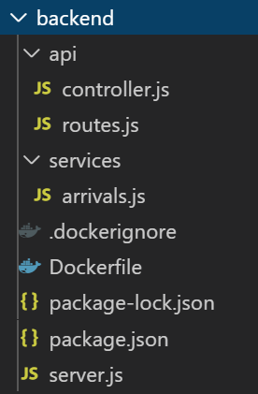
Backend
The backend solution consists in a Restful API Microservice developed using Node JS and Express.
The frontend UI calls the API endpoint (/api/v1/opensky/stats/:airport/:begin/:end) specified in ‘route.js’.
The API endpoint makes a GET request to the function “getArrivals” defined in ‘controller.js’.
The function “getArrivals” calls the function “getArrivalsAPI” defined in the service “arrivals.js”.
The function “getArrivalsAPI” makes the request to the external API provided by OpenSky Network.
The data is sent back to the frontend UI.

Slide 5
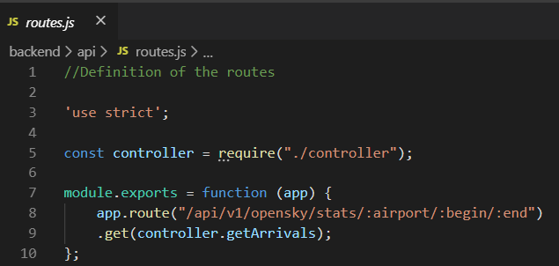
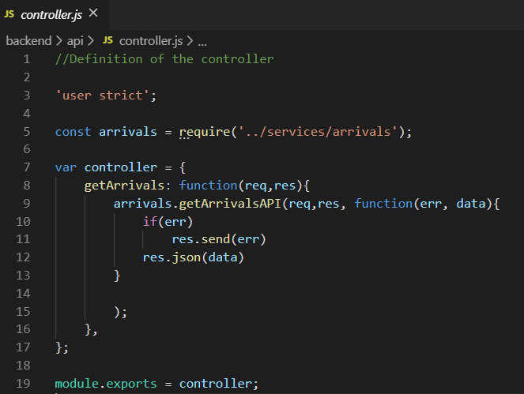
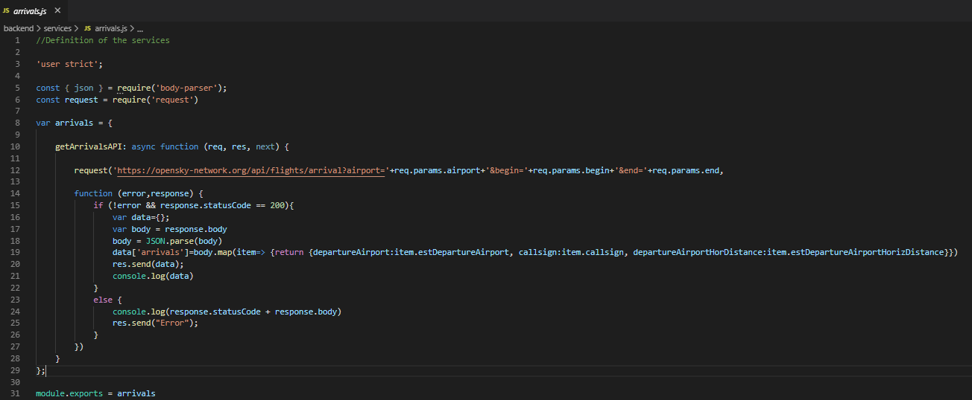
Backend
route.js
controller.js
Frontend UI calls API
arrivals.js
Return data to frontend UI

Slide 6


Frontend
The frontend solution consists in a web application developed using Angular framework together with HTML, CSS and JavaScript.
The following features are implemented:
A dropdown list with available airports and a date picker to select begin date and end date.
A table that shows the results for the given inputs. The table allows pagination, sorting and hide/show columns.
A map image showing the location of the arrival airport and the departure airports.

Slide 7
Frontend
User inputs
Airport
Initial and end date and time

Slide 8
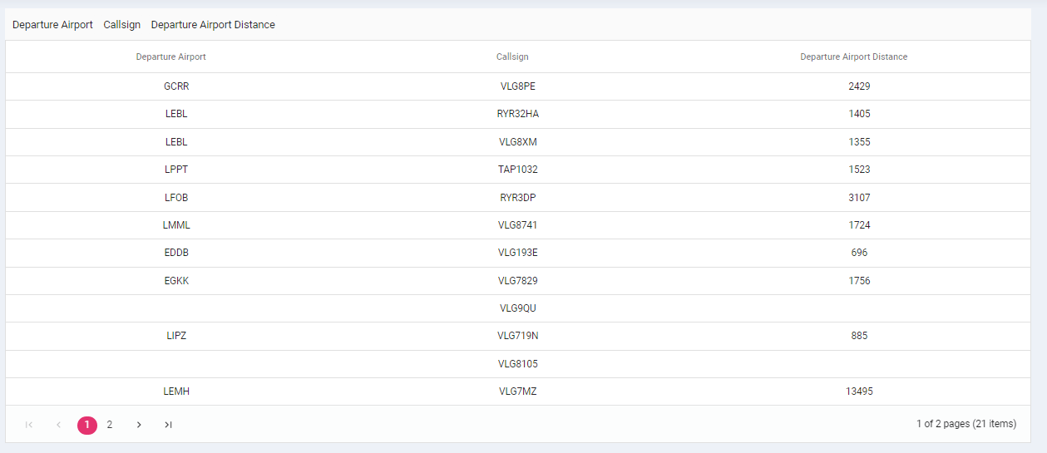
Frontend
Hide/Show columns
Sorting available
Pagination

Slide 9
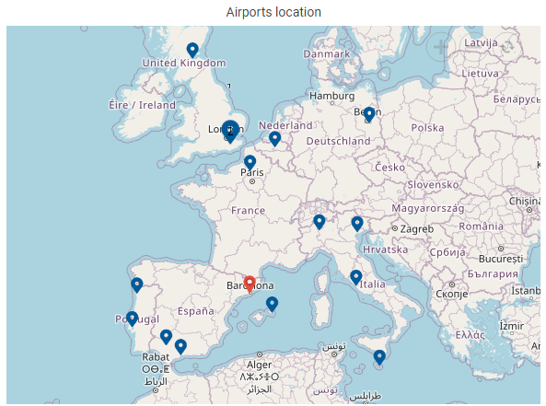


Frontend
Zoom In/Out
Arrival airport
Departure airports

Slide 10
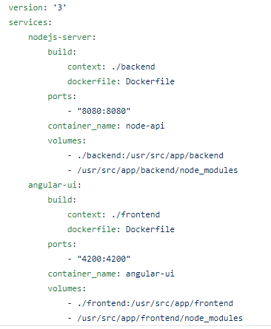
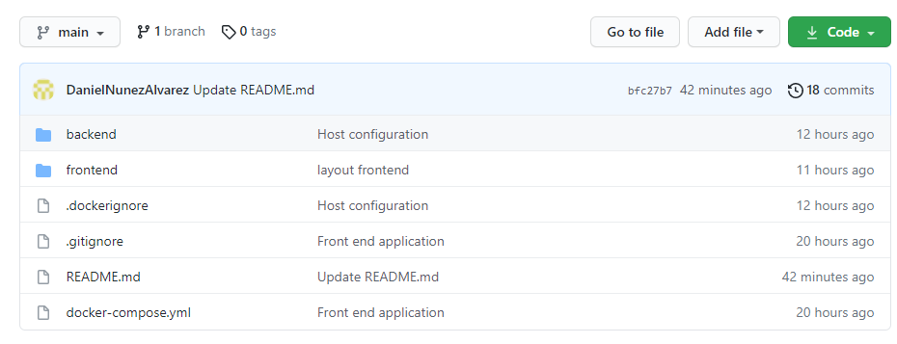
DevOps
GitHub repository
docker-compose.yml
https://github.com/DanielNunezAlvarez/opensky.git

Slide 11
Next steps
Implement authentication method in the backend microservice and the frontend user interface.
Improve interactive map (Performance with long array results, add aircraft position).
Improve test implementation.
Adapt the application to a Progressive Web Application (PWA).
Additional features and API calls (Flights by Aircraft, Departures for Airport, Track by Aircraft, ...).

